Slide 1

INTERVIEW EXPERIENCE
Team id : 662024-MI044
Sai Chandra -208R1A66G4
Naveen -208R1A66E6
Vinay -208R1A66F1
Pavan Kumar -208R1A66H8
Department of Computer Science and Engineering (AI & ML)
CMR Engineering College, Hyderabad

Slide 2
Agenda
•Introduction
•Abstract
•Literature Survey
•Software Requirement Specification
•Hardware Requirements
•Existing System
•Findings of Project(techniques and algorithms)
•Conclusion of the Project
•Future Enhancements
•References/ Bilibography

Slide 3

Introduction:
•"How to crack an Interview?" is a big question for any candidate looking for work.
•So, in this portal, we will go over all of the common possible points and tips, as well as crucially various "COMPANY INTERVIEW QUESTIONS", which will be very useful for candidates looking for a good job in a company.
•In this portal, a candidate who has recently participated in a company drive interview or a written exam can be anything.
•Anyone can go directly to the site link and search the Company's name to find all of the previous questions asked by the company for recruiting.
•There are also options to answer the question, discuss the question, like, comment, and so on.

Slide 4
Abstract:
Your success in a job interview depends a great deal on how you prepare for it. Interview preparation primarily involves researching the job and the company and thoughtfully considering your answers to the interview questions. In addition to pre-interview preparation, there are certain aspects you are required to prepare for during and after the interview.
What is the most effective way to prepare for an interview?
Connecting with seniors or alumni who have participated in a specific company interview, asking questions, discussing topics, and so on. This could be easily accomplished using this portal; anyone can use it to post questions, answer them, and review them. Anything related to interview questions, coding questions, important topics, preparation tips, and so on can be posted. Simply reading it would greatly aid the interview candidate's preparation

Slide 5
Literature Survey:
Let us got through some key statistical facts on Company Job interviews and hiring as of 2022
118 people apply for a single job, on average.
--> Job interviews last between 45 minutes and 1 hour.
-->Only 2% of candidates who apply for a job opening are selected for a job interview.
-->It takes between one and three job interviews to get an offer.
What are the prerequisites before attending an Interview?
-->Review the job description
-->Consider your eligibility for the job
-->Learn more about the company
Prepare a list of expected interview questions both technical and non-technical
-->Practice mock interviews
Our Aim is to built a website which can collect the list of expected interview questions relating to all companies.

Slide 6
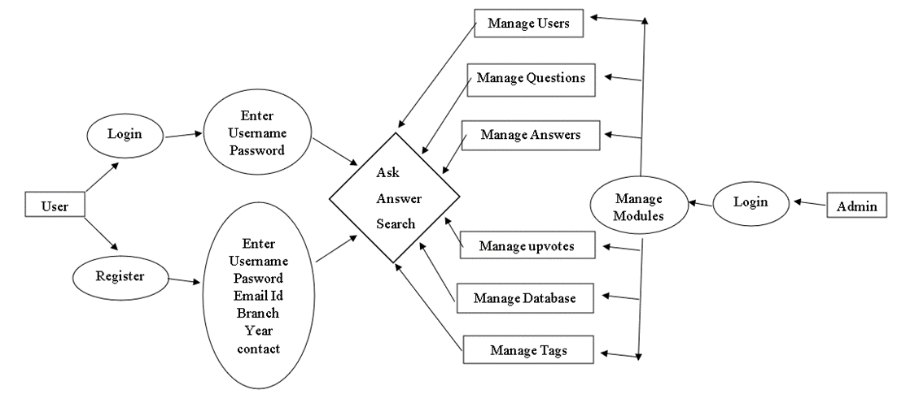
Conceptual Frameworks:

Slide 7

Software requirements :
Operating system : Windows 10/11, macOS 10. X,
Front-end tools : HTML, CSS
Back-end tools : PHP
Language : Python.

Slide 8
Hardware requirements:
Platform : Windows 10, macOS 10.X, Linux, Intel Core i7,
CPU : 4vCPU, Frequency: 2.2 GHz and Threads :16
RAM : 8 GB
Storage Configuration : 30 GB
15000 RPM drive or a tier 1 SAN storage (2-4 Bps SAN dedicated channel)

Slide 9
Existing Systems:
•Personally asking experienced personnel or seniors.
•Searching in the Internet.
•Using websites like Quora, InterviewBit , Indeed, Interviewprep etc and many more.
•There are many online, offline organization which provide free or paid courses on interview preparation, mock interviews, counselling, crash courses.

Slide 10
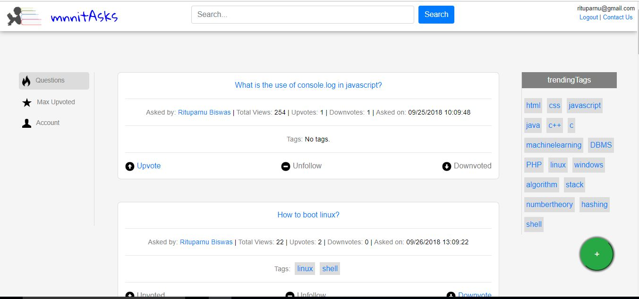
Home page:

Slide 11
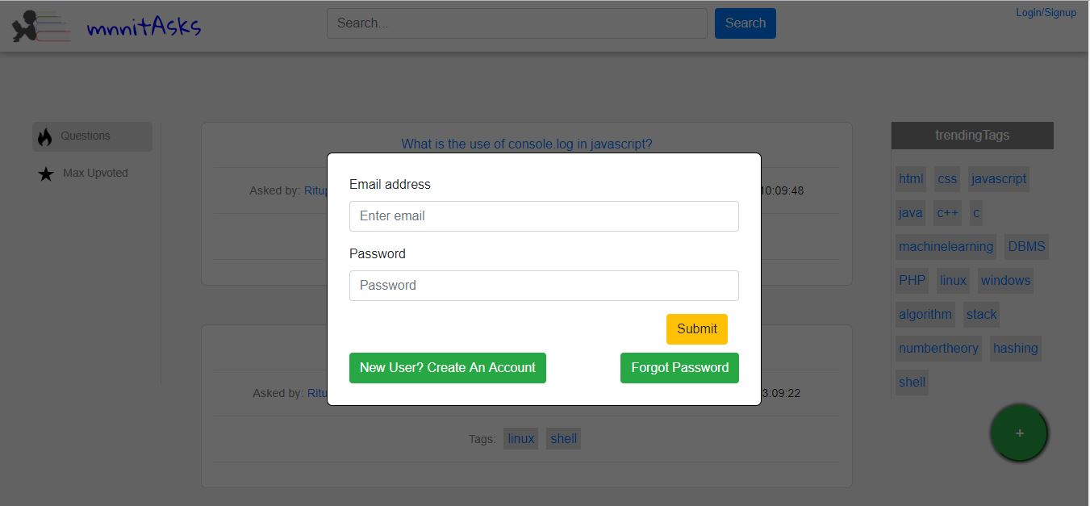
Login page:

Slide 12
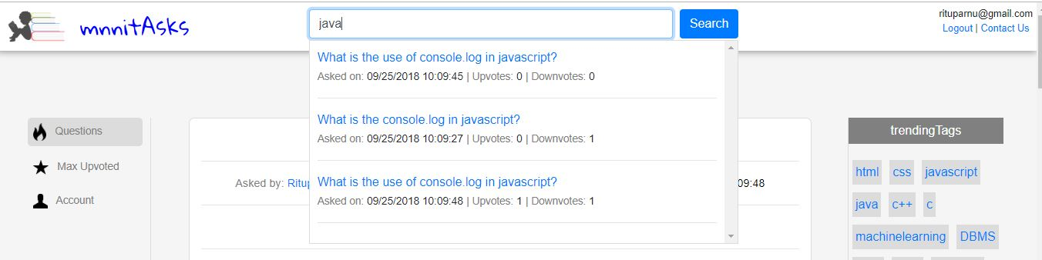
Search:

Slide 13
Conclusion:
Our project is a reliable and Self developing site, where the only inputs are from the users in the form of questions and answers. Generally, preparing for an interview might confuse few people and I would suggest this site could be Every helpful during this time. We made an all0in-one site where all the essential and required questions related to interview preparation, technical questions, aptitude questions, general questions etc can be posted as well as answered. This portal can act as a compilation of all the queries an aspirant may get while preparing for an interview.

Slide 14
Future enhancement:
Notifications : Further, notifications related to company placements, dates, internship, company drive updates etc..can be posted.
Spaces : With-in the website users with same interest can form their own community or team space.
Linking to other social Accounts : Users can be further be linked with their other social accounts like LinkedIn ,Facebook , twitter etc.

Slide 15
References:
https://www.w3schools.com/html/
https://www.w3schools.com/css/
https://www.w3schools.com/php/default.asp
https://www.w3schools.com/bootstrap/bootstrap_ver.asp
https://www.apachefriends.org/
https://stackoverflow.com/

Slide 16
Thank you

